Slide 1
Recursive Backtracking

Slide 2
Exercise: Combinations
Write a method combinations that accepts a string s and an integer k as parameters and outputs all possible k -letter words that can be formed from unique letters in that string. The arrangements may be output in any order.
Example: combinations("GOOGLE", 3) outputs the sequence of lines at right.
To simplify the problem, you may assume that the string s contains at least k unique characters.
EGL EGO ELG ELO EOG EOL GEL GEO GLE GLO GOE GOL | LEG LEO LGE LGO LOE LOG OEG OEL OGE OGL OLE OLG

Slide 3
Initial attempt
public static void combinations(String s, int length) {
combinations(s, "", length);
}
private static void combinations(String s, String chosen, int length) {
if (length == 0) {
System.out.println(chosen); // base case: no choices left
} else {
for (int i = 0; i < s.length(); i++) {
String ch = s.substring(i, i + 1);
if (!chosen.contains(ch)) {
String rest = s.substring(0, i) + s.substring(i + 1);
combinations(rest, chosen + ch, length - 1);
}
}
}
}
Problem: Prints same string multiple times.

Slide 4
Exercise solution
public static void combinations(String s, int length) {
Set<String> all = new TreeSet<String>();
combinations(s, "", all, length);
for (String comb : all) {
System.out.println(comb);
}
}
private static void combinations(String s, String chosen,
Set<String> all, int length) {
if (length == 0) {
all.add(chosen); // base case: no choices left
} else {
for (int i = 0; i < s.length(); i++) {
String ch = s.substring(i, i + 1);
if (!chosen.contains(ch)) {
String rest = s.substring(0, i) + s.substring(i + 1);
combinations(rest, chosen + ch, all, length - 1);
}
}
}
}

Slide 5
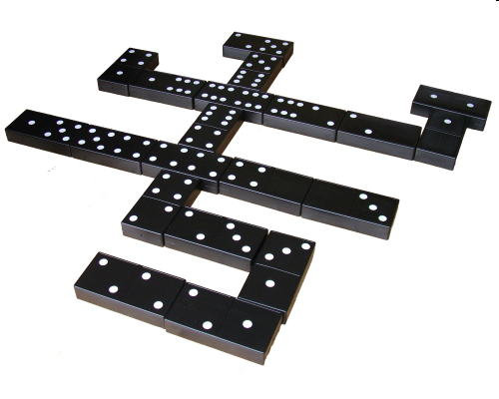
Exercise: Dominoes
The game of dominoes is played with small black tiles, each having 2 numbers of dots from 0-6. Players line up tiles to match dots.
Given a class Domino with the following methods:
public int first() // first dots value
public int second() // second dots value
public String toString() // e.g. "(3|5)"
Write a method hasChain that takes a List of dominoes and a starting/ending dot value, and returns whether the dominoes can be made into a chain that starts/ends with those values.
If the chain's start/end are the same, the answer is always true.

Slide 6
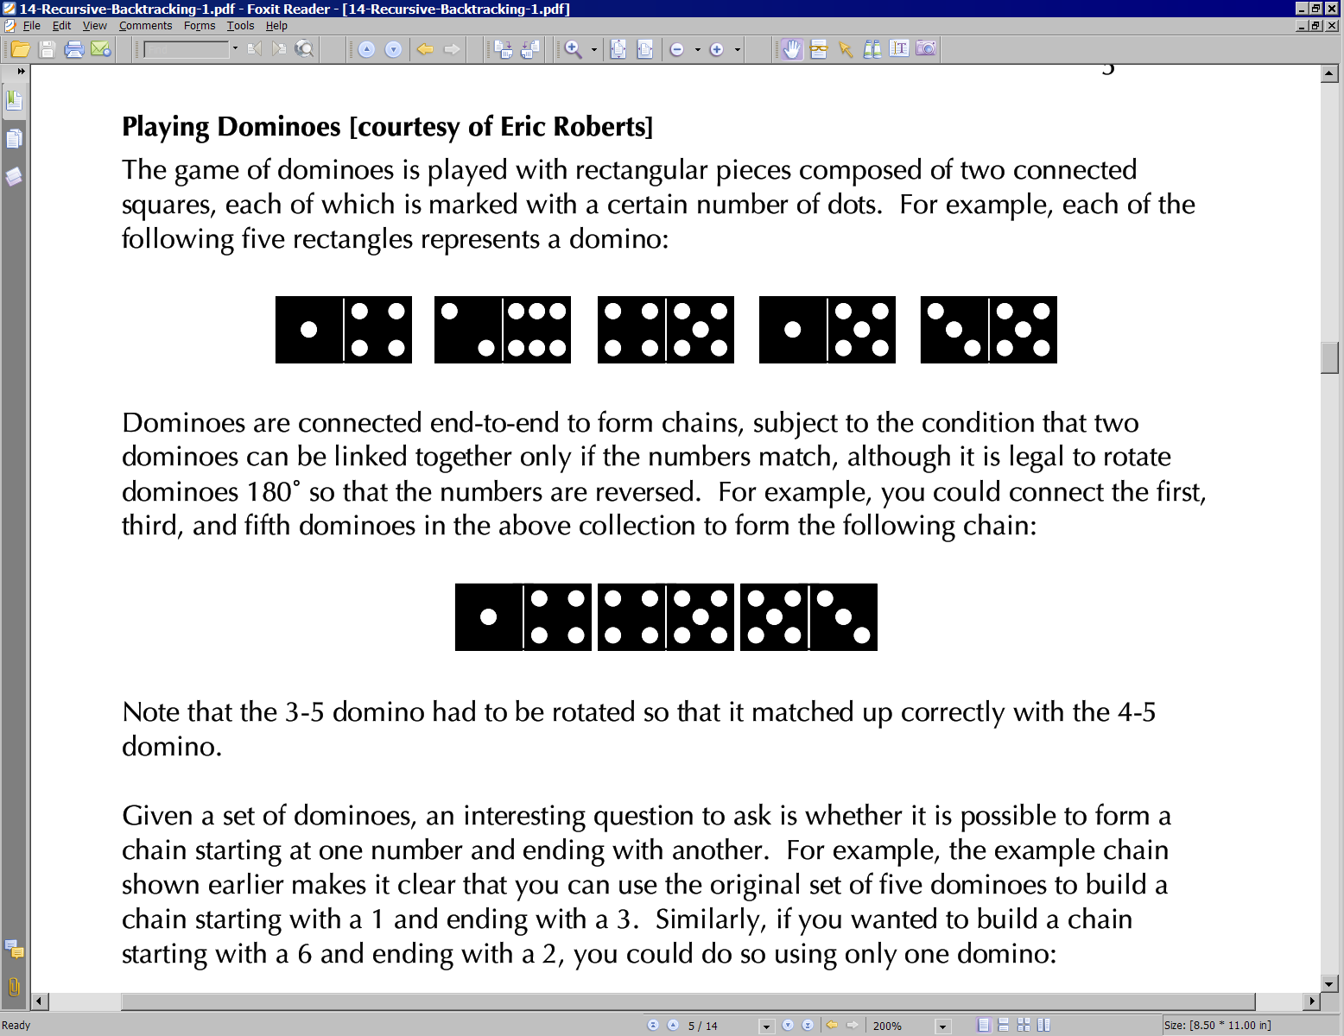
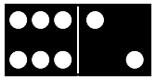
Domino chains
Suppose we have the following dominoes:
We can link them into a chain from 1 to 3 as follows:
Notice that the 3|5 domino had to be flipped.
We can "link" one domino into a "chain" from 6 to 2 as follows:

Slide 7
Exercise client code
import java.util.*; // for ArrayList
public class SolveDominoes {
public static void main(String[] args) {
// [(1|4), (2|6), (4|5), (1|5), (3|5)]
List<Domino> dominoes = new ArrayList<Domino>();
dominoes.add(new Domino(1, 4));
dominoes.add(new Domino(2, 6));
dominoes.add(new Domino(4, 5));
dominoes.add(new Domino(1, 5));
dominoes.add(new Domino(3, 5));
System.out.println(hasChain(dominoes, 5, 5)); // true
System.out.println(hasChain(dominoes, 1, 5)); // true
System.out.println(hasChain(dominoes, 1, 3)); // true
System.out.println(hasChain(dominoes, 1, 6)); // false
System.out.println(hasChain(dominoes, 1, 2)); // false
}
public static boolean hasChain(List<Domino> dominoes,
int start, int end) {
...
}
}

Slide 8
Exercise solution
public static boolean hasChain(List<Domino> dominoes,
int start, int end) {
if (start == end) {
return true; // base case
} else {
for (int i = 0; i < dominoes.size(); i++) {
Domino d = dominoes.remove(i); // choose
if (d.first() == start) { // explore
if (hasChain(dominoes, d.second(), end)) {
return true;
}
} else if (d.second() == start) {
if (hasChain(dominoes, d.first(), end)) {
return true;
}
}
dominoes.add(i, d); // un-choose
}
return false;
}
}

Slide 9
Exercise: Print chain
Write a variation of your hasChain method that also prints the chain of dominoes that it finds, if any.
hasChain(dominoes, 1, 3);
[(1|4), (4|5), (5|3)]

Slide 10
Exercise solution
public static boolean hasChain(List<Domino> dominoes, int start, int end) {
Stack<Domino> chosen = new Stack<Domino>();
return hasChain(dominoes, chosen, start, end);
}
private static boolean hasChain(List<Domino> dominoes,
Stack<Domino> chosen, int start, int end) {
if (start == end) {
System.out.println(chosen);
return true; // base case
} else {
for (int i = 0; i < dominoes.size(); i++) {
Domino d = dominoes.remove(i); // choose
if (d.first() == start) { // explore
chosen.push(d);
if (hasChain(dominoes, chosen, d.second(), end)) {
return true;
}
chosen.pop();
} else if (d.second() == start) {
d.flip();
chosen.push(d);
if (hasChain(dominoes, chosen, d.second(), end)) {
return true;
}
chosen.pop();
}
dominoes.add(i, d); // un-choose
}
return false;
}
}

Slide 11
The "8 Queens" problem
Consider the problem of trying to place 8 queens on a chess board such that no queen can attack another queen.
What are the "choices"?
How do we "make" or "un-make" a choice?
How do we know when to stop?
Q
 |  |  |  |  | Q
 |  |  |  |  |  |  | Q
 |  | Q
 |  |  |  |  |  | Q
 |  |  | Q
 | Q
 |  |  |  | Q

Slide 12
Naive algorithm
 | 1 | 2 | 3 | 4 | 5 | 6 | 7 | 8
1 | Q | ... | ... | ... | ... | ... | ... | ...
2 | ... | ... | ... | ... | ... | ... | ... | ...
3 | ...
4
5
6
7
8
for (each square on board):
Place a queen there.
Try to place the rest of the queens.
Un-place the queen.
How large is the solution space for this algorithm?
64 * 63 * 62 * ...

Slide 13
Better algorithm idea
 | 1 | 2 | 3 | 4 | 5 | 6 | 7 | 8
1 | Q | ... | ...
2 |  | ... | ...
3 |  | Q | ...
4 |  |  | ...
5 |  |  | Q
6
7
8
Observation: In a working solution, exactly 1 queen must appear in each row and in each column.
Redefine a "choice" to be valid placement of a queen in a particular column.
How large is the solution space now?
8 * 8 * 8 * ...

Slide 14
Exercise
Suppose we have a Board class with the following methods:
Write a method solveQueens that accepts a Board as a parameter and tries to place 8 queens on it safely.
Your method should stop exploring if it finds a solution.
Method/Constructor | Description
public Board(int size) | construct empty board
public boolean isSafe(int row, int column) | true if queen can be safely placed here
public void place(int row, int column) | place queen here
public void remove(int row, int column) | remove queen from here
public String toString() | text display of board

Slide 15
Exercise solution
// Searches for a solution to the 8 queens problem
// with this board, reporting the first result found.
public static void solveQueens(Board board) {
if (!explore(board, 1)) {
System.out.println("No solution found.");
} else {
System.out.println("One solution is as follows:");
System.out.println(board);
}
}
...

Slide 16
Exercise solution, cont'd.
// Recursively searches for a solution to 8 queens on this
// board, starting with the given column, returning true if a
// solution is found and storing that solution in the board.
// PRE: queens have been safely placed in columns 1 to (col-1)
public static boolean explore(Board board, int col) {
if (col > board.size()) {
return true; // base case: all columns are placed
} else {
// recursive case: place a queen in this column
for (int row = 1; row <= board.size(); row++) {
if (board.isSafe(row, col)) {
board.place(row, col); // choose
if (explore(board, col + 1)) { // explore
return true; // solution found
}
b.remove(row, col); // un-choose
}
}
return false; // no solution found
}
}

